Slide 1
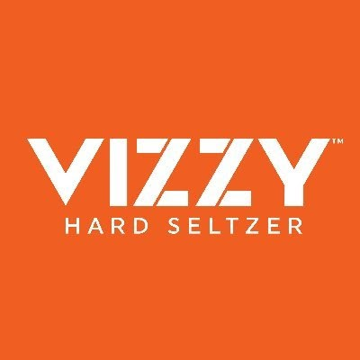
VIZZY
By: Sean Fagen, Michael Friedriger, Jamie Fruncillo, Liam Harrison and Nolan Hartwell

Slide 2
Agenda
Background of Vizzy
Identifying main competitors
Introducing our new product
SWOT
Target market and market positioning
Creative brief
Budgets
Advertising creatives
Conclusion

Slide 3
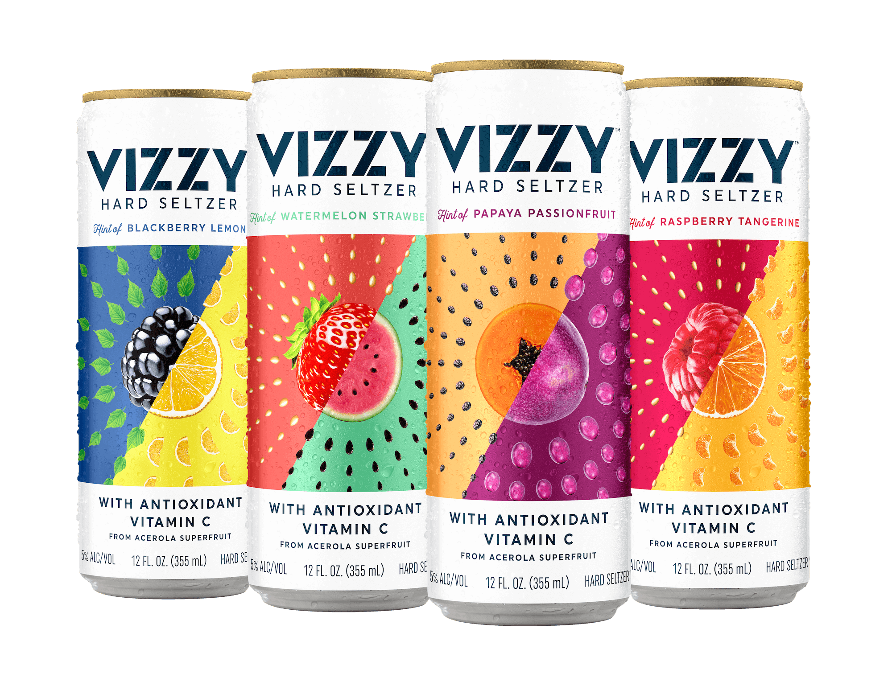
BACKGROUND INFORMATION – VIZZY BRAND
Owned by Molson Coors Beverage Co
Launched in 2020
First Hard Seltzer to be made from Acerola Superfruit
30x more Vitamin C than an orange
100 calories, 2g carbs, 1g sugar and 5% alcohol with 10 different flavors!

Slide 4
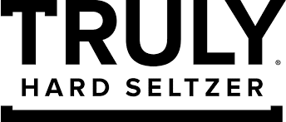
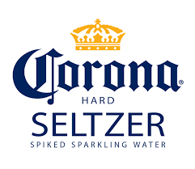
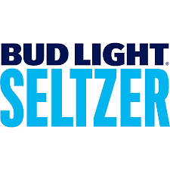
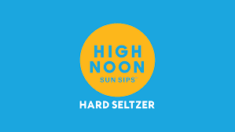
COMPETITION

Slide 5
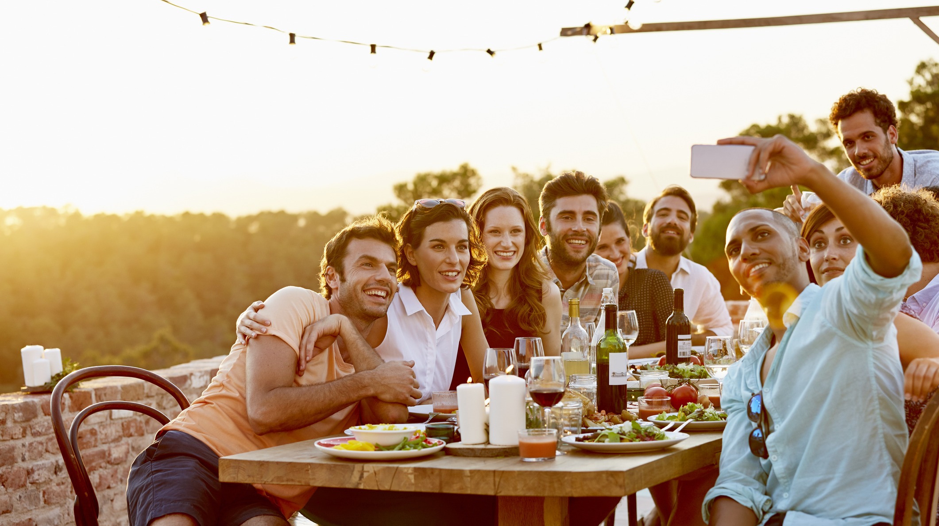
Hard Seltzer Advertising
Viral Marketing
“Ain’t no laws when you’re drinking claws!”
“White Claw Summer”
Gender Neutral Marketing
Avoiding the mistakes of traditional beer/wine advertising
Young men and women being active and having fun together, often outside
Traditional Marketing
Anheuser-Busch and Constellation Brands
Leverage well-known brand image
Social Media Marketing
Targeted towards younger demographics
Healthy, Low Calorie, Outside/Active

Slide 6
White Claw Commercial:
https://youtu.be/V2TMHsBBJX4

Slide 7
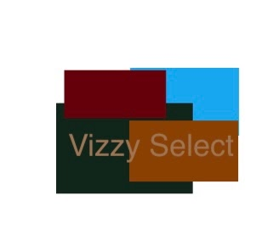
Our New Product
Vizzy Select
Simpler packaging,
Put into a bottle instead of a can
Slight changes to the flavors offered , straightforward names instead of using a lot of descriptive words
Same health benefits (Antioxidant Vitamin C) as familiar Vizzy product lines, but targeted towards a slightly older demographic

Slide 8
VIZZY Bottle

Slide 9
VIZZY Packaging

Slide 10
Strengths, Weaknesses, Opportunities, Threats
Strengths
VIZZY is growing
VIZZY has done well in
a short amount of time
VIZZY is a health-conscious
brand
Weaknesses
May be hard to break into the
market of older men
Customer loyalty
Not established when it comes
to this target market
Opportunities
Not many beer companies have created this idea
Threats
Already well-established beer companies could create this product and be successful faster

Slide 11
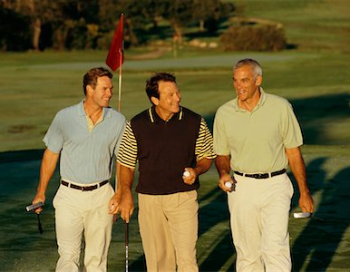
Target market and Market strategy
35 to 45 year-old males
We noticed that not many alcohol brands seem to not be concerned with the health aspect of alcohol
Everyone is aware drinking can be unhealthy; the calories add up
We believe that men would be more interested in Vizzy if the packaging and advertising was geared more towards them
Less vibrant colors; advertisements with more gender inclusivity
35-45 is an important age to stay on top of your health to avoid serious issues in the future.

Slide 12
Budget breakdown
$84,605, 812

Slide 13
IMC Mix

Slide 14
Current Advertising from VIZZY
https://youtu.be/1DjGbK5zPD0
https://youtu.be/KZe9DoVWsWU

Slide 15
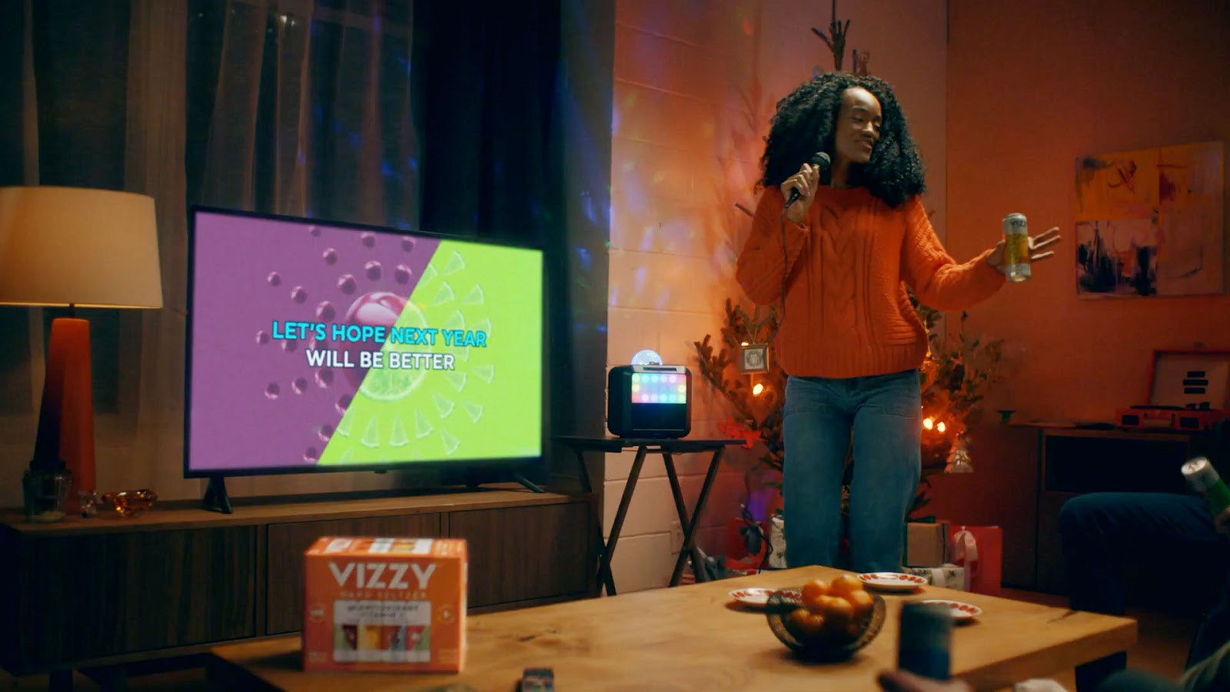
VIZZY Advertising Continued

Slide 16
Continued

Slide 17
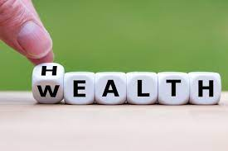
Our Advertising Ideas
Continue to emphasize health benefits
Target more health-conscious users
Focus on unwinding while still caring about health
Use of celebrity athletes as spokesperson

Slide 18
Billboard Ad

Slide 19
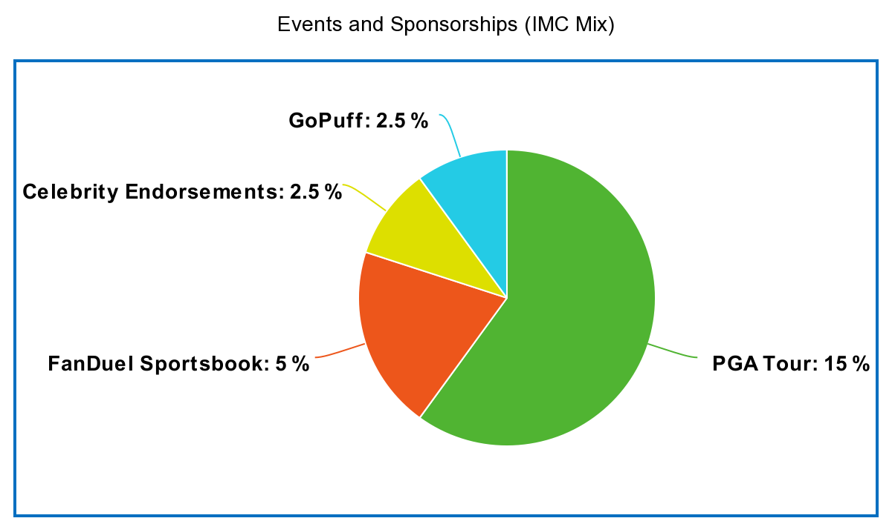
Events and Sponsorships
25 percent of budget towards events
and sponsorships ($12,690,871)
PGA: $12,690,871
Fanduel: $4,230,291
Celebrity: $2,115,145
Gopuff: $2,115,145

Slide 20
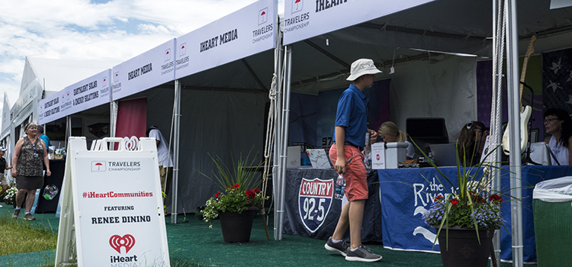
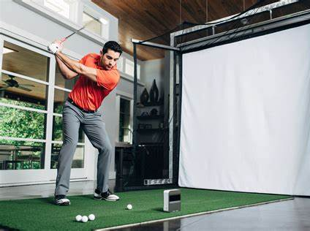
PGA Sponsorship
Title Sponsor or “Marketing Partner”
Free Longest Drive Competitions
Golf Simulator
Free Product Samples
Followed by Short Questionnaire to Gauge Customer Sentiment
Estimated Cost: $8-13 million
Branding at Tee Boxes, Branded Tents, and Banners around the course

Slide 21
Conclusion
Vizzy is a healthy alternative to other hard seltzers
Our new product would be focused on an older audience
Emphasize the health benefits
Gain brand awareness through our IMC mix

